Slide 1
Types of Optimizers in Deep Learning

Slide 2
Outline
Role of optimizers in Neural Networks
Types of Optimizers in Deep Learning
Gradient Descent
Mini batch Gradient Descent
Stochastic Gradient Descent
Gradient Descent with Momentum
RMSprop
Adam

Slide 3
A deep learning model comprises an input, output, activation function, loss function, hidden layers, etc.
All deep learning models generalize the data through an algorithm and make predictions on the unseen data.
You require an algorithm that maps the inputs’ examples to that of the outputs as well as an optimization algorithm.
The particular optimization algorithm searches the parameters’ value, minimising the error while mapping the inputs to outputs.
Such optimizers and optimization significantly influence the accuracy of the deep learning model.
Moreover, they influence the model’s speed training.

Slide 4
Optimizers
In machine learning, optimizers and loss functions are two components that help improve the performance of the model.
By calculating the difference between the expected and actual outputs of a model, a loss function evaluates the effectiveness of a model.
Among the loss functions are log loss, hinge loss, and mean square loss.
By modifying the model’s parameters to reduce the loss function value, the optimizer contributes to its improvement.
RMSProp, ADAM, and SGD are a few examples of optimizers. The optimizer’s job is to determine which combination of the neural network’s weights and biases will give it the best chance to generate accurate predictions.

Slide 5
Overview
Optimization Algo
Model
input
Prediction
Dataset
expected output
Loss Function
Loss

Slide 6
When training a deep learning model, you must adapt every epoch’s weight and minimize the loss function.
An optimizer is an algorithm or function that adapts the neural network’s attributes, like learning rate and weights. Hence, it assists in improving the accuracy and reduces the total loss.
But it is a daunting task to choose the appropriate weights for the model. This is because a deep learning model usually comprises millions of parameters.
You can use various optimizers to modify your learning rate and weights. But selecting the best optimizer in deep learning depends on your application.

Slide 7
Terminologies
Sample: It depicts a single row of a dataset.
Epoch: It denotes the number of times the algorithm operates on the entire training dataset.
Batch: It is the number of samples to be considered for updating the model parameters.
Cost Function/Loss Function: A cost function helps you calculate the cost, representing the difference between the actual value and the predicted value.
Learning rate: It offers a degree that denotes how much the model weights should be updated.
Weights/ Bias: They are learnable parameters that control the signal between two neurons in a deep learning model.

Slide 8
Gradient Descent
This is the most basic optimizer that directly uses the derivative of the loss function and learning rate to reduce the loss and achieve the minima.
This approach is also adopted in backpropagation in neural networks where the updated parameters are shared between different layers depending upon when the minimum loss is achieved.
It is easy to implement and interpret the results, but it has various issues.
The weights are updated when the whole dataset gradient is calculated, which slows down the process.
It also requires a large amount of memory to store this temporary data, making it a resource-hungry process.
Though the idea behind this algorithm is well suited, it needs to be tweaked.

Slide 9
Gradient descent (GD) is an iterative first-order optimization algorithm, used to find a local minimum of a given function.
This method is commonly used in machine learning (ML) and deep learning (DL) to minimize a cost/loss function (e.g. in a linear regression).
This method was proposed long before the era of modern computers by Augustin-Louis Cauchy in 1847

Slide 10
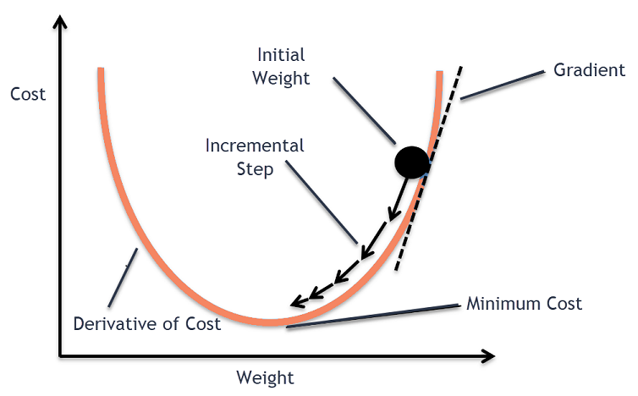
Gradient descent was originally proposed by CAUCHY in 1847. It is also known as steepest descent.

Slide 11
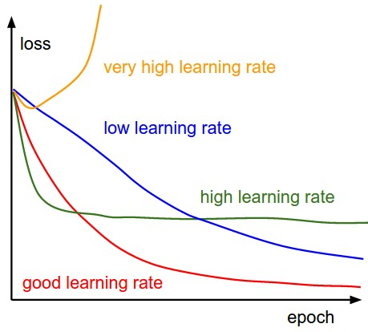

Slide 12
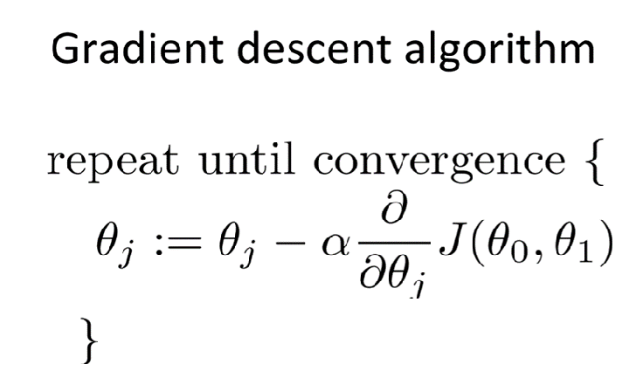

Slide 13
Batch Gradient Descent
Batch gradient descent updates the model’s parameters using the gradient of the entire training set.
It calculates the average gradient of the cost function for all the training examples and updates the parameters in the opposite direction.
Batch gradient descent guarantees convergence to the global minimum, but can be computationally expensive and slow for large datasets.

Slide 14
Stochastic Gradient Descent
Stochastic gradient descent updates the model’s parameters using the gradient of one training example at a time.
It randomly selects a training example, computes the gradient of the cost function for that example, and updates the parameters in the opposite direction.
Stochastic gradient descent is computationally efficient and can converge faster than batch gradient descent.
However, it can be noisy and may not converge to the global minimum.

Slide 15
Mini-Batch Gradient Descent
Mini-batch gradient descent updates the model’s parameters using the gradient of a small subset of the training set, known as a mini-batch.
It calculates the average gradient of the cost function for the mini-batch and updates the parameters in the opposite direction.
Mini-batch gradient descent algorithm combines the advantages of both batch and stochastic gradient descent, and is the most commonly used method in practice.
It is computationally efficient and less noisy than stochastic gradient descent, while still being able to converge to a good solution.

Slide 16
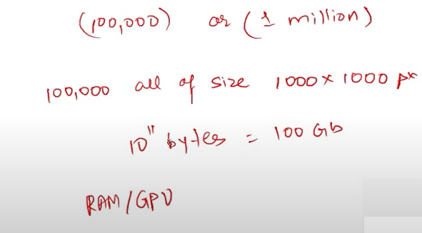
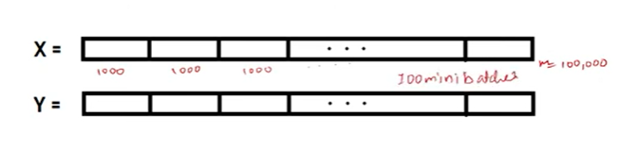
Mini Batch

Slide 17
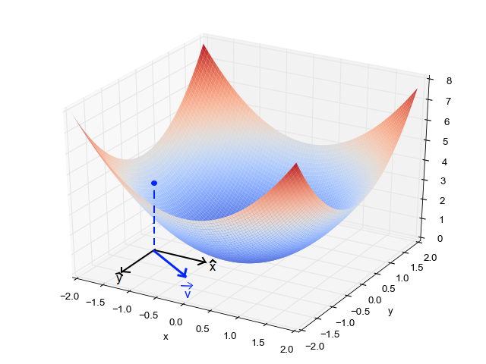
Plotting the Gradient Descent Algorithm
When we have a single parameter (theta), we can plot the dependent variable cost on the y-axis and theta on the x-axis.
If there are two parameters, we can go with a 3-D plot, with cost on one axis and the two parameters (thetas) along the other two axes.

Slide 18
Local Minima
The cost function may consist of many minimum points.
The gradient may settle on any one of the minima, which depends on the initial point (i.e initial parameters(theta)) and the learning rate.
Therefore, the optimization may converge to different points with different starting points and learning rate.

Slide 19
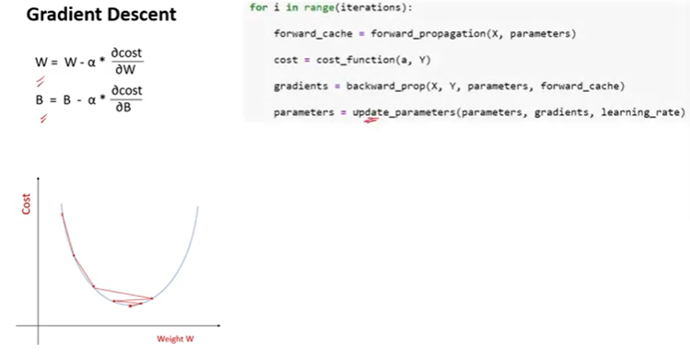

Slide 20
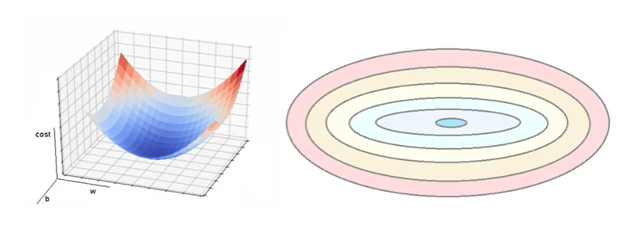
Top view of the 3D Surface!

Slide 21
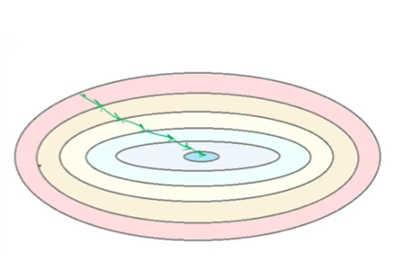

Slide 22
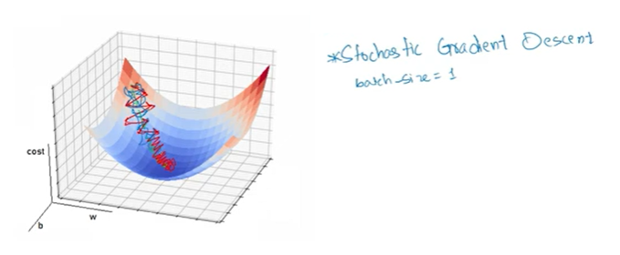
Plot for the 2 weight parameters

Slide 23
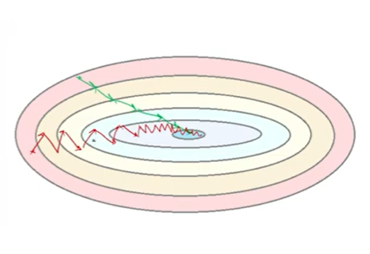

Slide 24
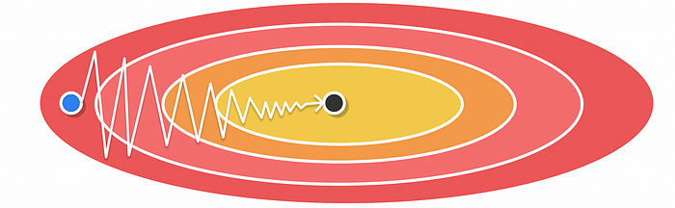
Example of an optimization problem with gradient descent in a ravine area.
A ravine is an area where the surface is much more steep in one dimension than in another

Slide 25
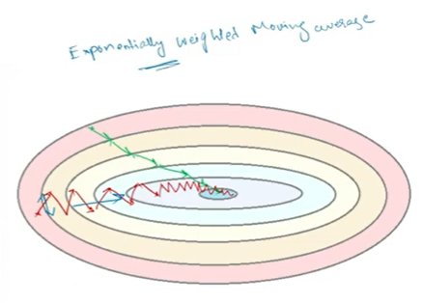

Slide 26
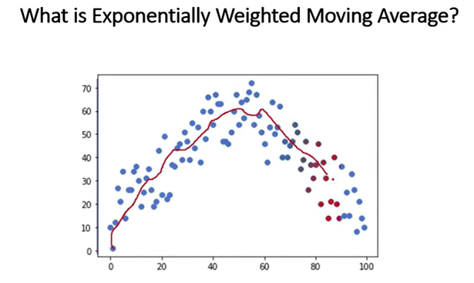


Slide 27
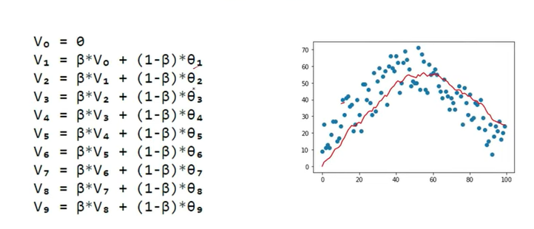

Slide 28
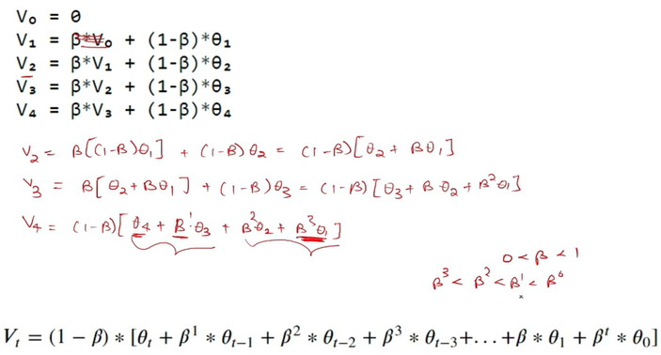

Slide 29
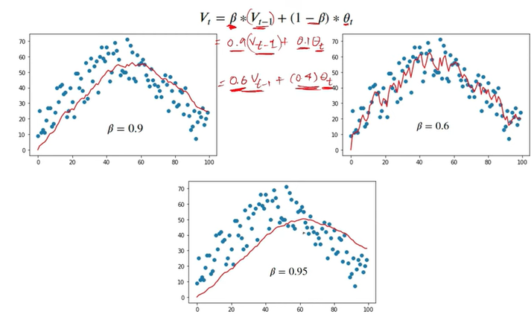

Slide 30
https://www.youtube.com/watch?v=M2xkmc2oHUc&t=132s

Slide 31
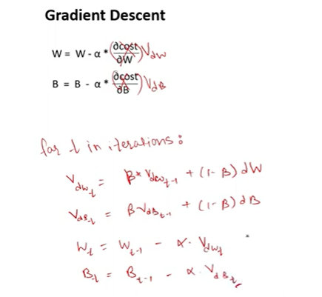
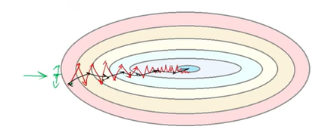

Slide 32
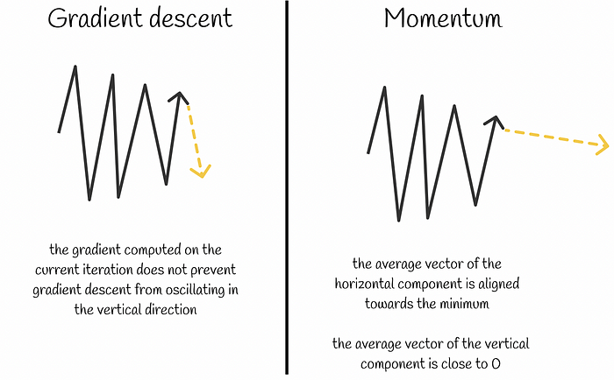

Slide 33
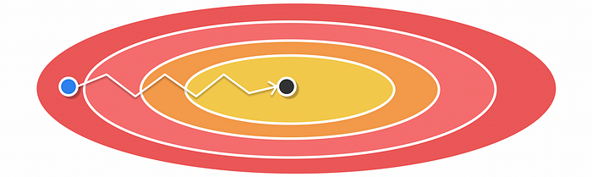
Optimization with Momentum

Slide 34

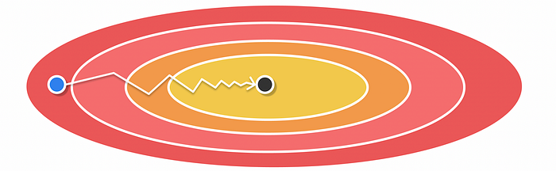
AdaGrad (Adaptive Gradient Algorithm)
Optimization with AdaGrad

Slide 35
RMSProp (Root Mean Square Propagation)
RMSProp was elaborated as an improvement over AdaGrad which tackles the issue of learning rate decay.
Similarly, to AdaGrad, RMSProp uses a pair of equations for which the weight update is absolutely the same.
However, instead of storing a cumulated sum of squared gradients dw² for vₜ, the exponentially moving average is calculated for squared gradients dw².

Slide 36
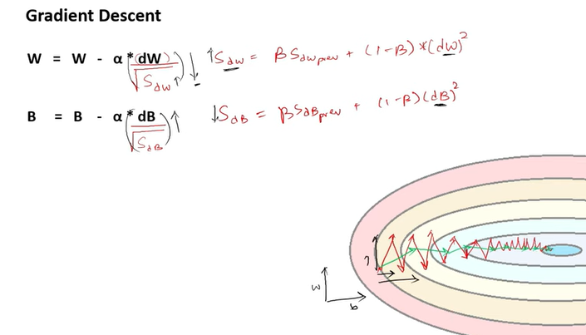

Slide 37
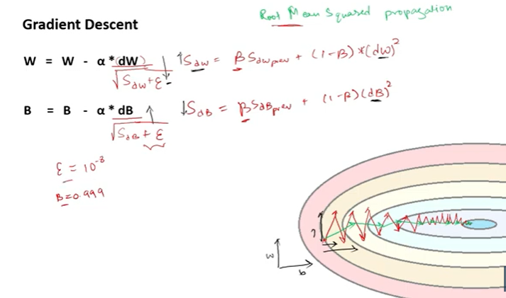

Slide 38
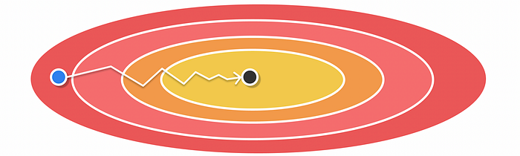
Optimization with RMSProp

Slide 39
Adam (Adaptive Moment Estimation)
At a high level, Adam combines Momentum and RMSProp algorithms.
To achieve it, it simply keeps track of the exponentially moving averages for computed gradients and squared gradients respectively.

Slide 40
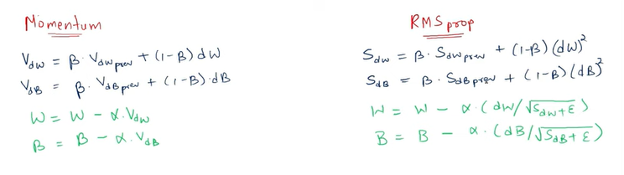

Slide 41
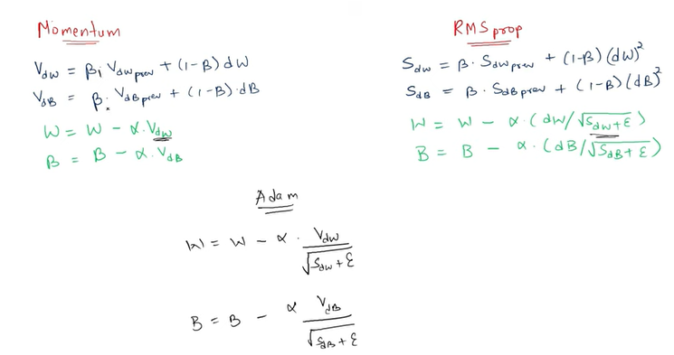

Slide 42
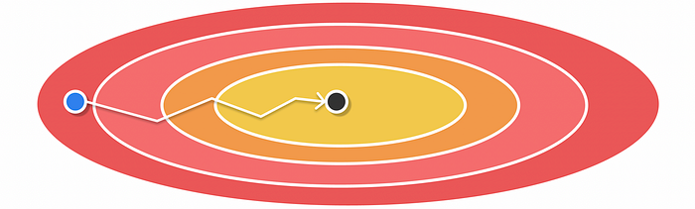
According to the Adam paper, good default values for hyperparameters are β₁ = 0.9, β₂ = 0.999, ε = 1e-8.

Slide 43
Conclusion
We have looked at different optimization algorithms in neural networks.
Considered as a combination of Momentum and RMSProp, Adam is the most superior of them which robustly adapts to large datasets and deep networks.
Moreover, it has a straightforward implementation and little memory requirements making it a preferable choice in the majority of situations.

Slide 44
portions for exam
KNN, Decision tree (entropy), CNN, Vanishing Gradient, Optimizers

